Slide 1
histogram on const mod different cov(x,y)

Slide 2
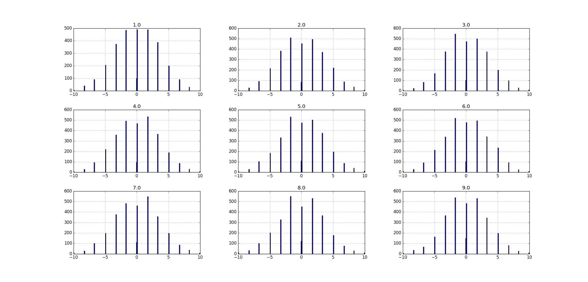
recovered x hist per cov (1-9) at 3 bins mod 5, var(x)=var(y)=10
y is perfectly recovered, we don’t do modulo or quantization on y.
we recover x by y.
each graph has it’s own mse, but we cannot tell which is the best modulo by those graphs

Slide 3
x,y before and after A multiplication

Slide 4
eigenvalues of A
if we do SVD on A matrix we decompose A to rotation and scaling
the scaling is by the eigenvectors
integer matrix can have only integer value at the determinant
(we don’t want 0 determinant because we cannot invert the output)
so we actually will get the same or more variance after multiplication at A
so modulo size will have to be bigger (or the same) as the initial X,Y module and we save nothing…

Slide 5
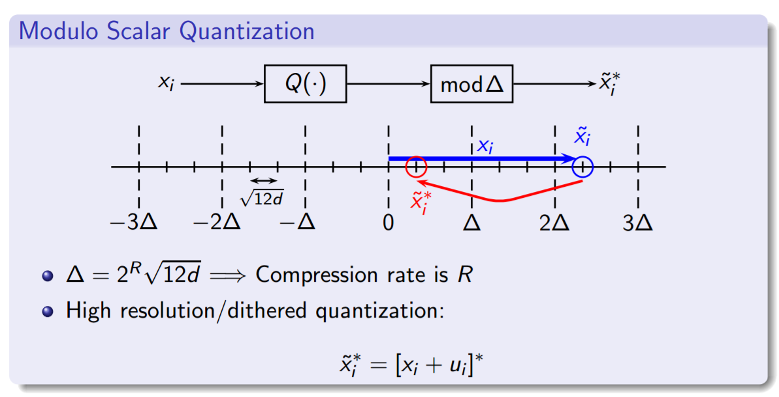
target – get smaller variance of X after A
but we actually have to put here the modulo size to be – let say to 3 delta instead of 1

Slide 6
but we actually get more variance after A
some examples of before – after A:

Slide 7
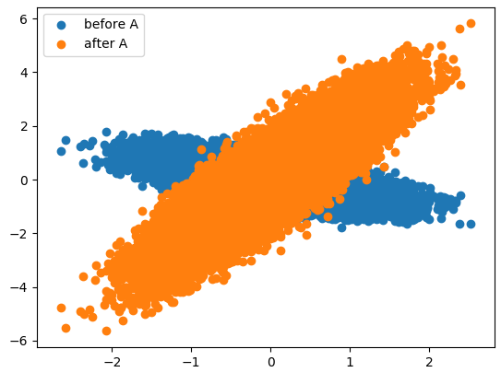
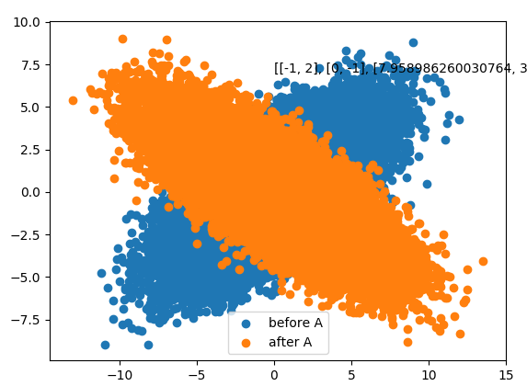
matrix: [[ 1 0] [ 1 -2]] eigenvalues: [-2. 1.] det: -2.0
matrix:
[[-1 2]
[ 0 -1]]
eigenvalues: [-1. -1.]
det: 1.0

Slide 8
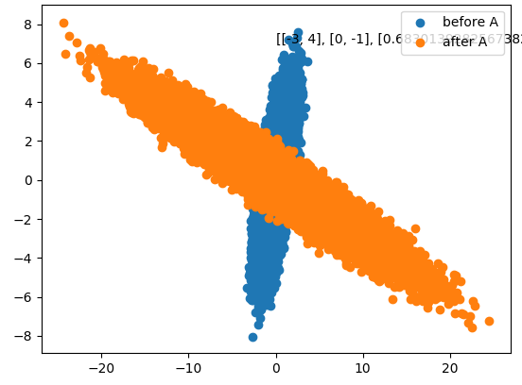
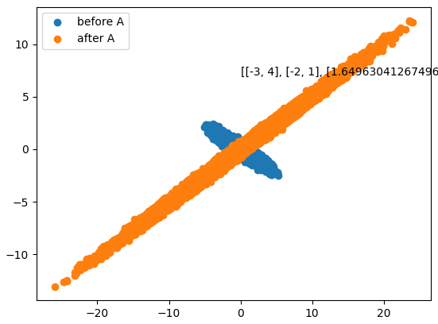
eigenvalues: [-3. -1.] det: 3.0
eigenvalues: [-1.+2.j -1.-2.j]
det: 5.0

